Slide 1
Making this resource work for you
Prior to teaching this lesson, please refer to the ‘Unit Overview and Planning Document’.
Further guidance on planning Science Mastery lessons can be found in the detailed planning guidance document.
Refer to the ‘notes’ section on each slide for useful information, including suggested expositions, pedagogical content knowledge, suggested questions, answers and more. Consider using presenter mode so you can see this guidance throughout the lesson.
The introduction slides can be adapted to suit your teaching style and the needs of your class.
Before the lesson, adapt the fix-it slide to address any misconceptions identified in the previous lesson’s exit ticket.
Choose from the suggested activities to suit your class. The intention is not that you complete all of these, but that you select those which ones are most appropriate for your students. It may be appropriate to further adapt activities for your students.
These lessons are designed to occupy approximately 1 hour. To adapt for a shorter or longer lesson duration we advise you to adapt the activity section accordingly.
Please consider using the final slide to send feedback about this lesson or examples of PowerPoints that you have adapted to our design team. Your feedback is used to improve Science Mastery for all of our teachers and students. We appreciate all suggestions and comments.
Thank you for reading!
The Science Mastery Team

Slide 2
Taking it Further: Calculating Unknown Concentrations
Answer the questions below.
State the quantity that is measured with the unit mol/dm³.
Calculate the concentration (in mol/dm³) of a solution that has 2 moles of solute dissolved in 100 cm³ of solution.
Complete the following general equation: Acid + Alkali →
4. What type of reaction is described in question 3?
5. State the colour of universal indicator in an acidic solution.
Concentration.
20 mol/dm³
Salt + water
A neutralisation reaction
Red/Orange
Notes:
Big idea: Reactions rearrange matter
Foundation: What type of solution would have a pH of 10?
Stretch: What type of ions would be present in a solution with a pH of 10?
Answers:
Foundation: An alkaline solution (alkali)
Stretch: OH⁻ ions (hydroxide ions)

Slide 3
Taking it Further: Calculating Unknown Concentrations
Do Now:
State the quantity that is measured with the unit mol/dm³.
Calculate the concentration of a solution that has 2 moles of solute dissolved in 100 cm³ of solution.
Complete the following general equation: Acid + Alkali →
What type of reaction is described in question 3?
State the colour of universal indicator in an acidic solution.
Drill:
1. What type of solution would have a pH of 10?
2. What type of ions would be present in a solution with a pH of 10?
3. Which electrode would these ions travel towards in electrolysis?
Notes:
Do Now answers:
Concentration
20 mol/dm³
Salt + water
A neutralisation reaction
Red/Orange
Drill answers:
An alkaline solution
OH⁻ ions (hydroxide ions)
These ions would travel towards the positive electrode (anode) because they are negatively charged.

Slide 4
Taking it Further: Calculating Concentration
Read Now:
Depression is a serious risk to the mental health of people around the world. Low vitamin D levels in the blood are associated with a greater risk of depression. This is especially concerning for those of us living in the UK and Ireland. This is because humans naturally get our vitamin D from sunlight, which we don’t get a lot of in our countries, especially in winter! Those of us who spend a lot of time indoors, or who wear clothes that cover up most of our skin, are at a greater risk of vitamin D deficiency. Doctors recommend that most people living here take a vitamin D supplement, especially during the winter months when we get the least amount of sunlight. Scientists recently carried out a study to investigate the blood concentration of vitamin D in 56 patients (aged 18-60 years), all of whom had mild to moderate depression. They found that following 8 weeks of vitamin D supplementation, a significant proportion of patients reported a reduction in the severity of their depression.
What is the relationship between vitamin D and depression?
Why is this relationship especially important for us to understand in the UK and Ireland?
Why do doctors recommend that people take vitamin D supplements in the winter months?
What did scientists find out in their study?
Notes:
Answers:
Low blood concentration levels of vitamin D are associated with a greater risk of depression
In the UK and Ireland, we don’t get a lot of sunlight during the winter months especially. Many people spend lots of time indoors or usually have their skin covered. Therefore we are at a greater risk of vitamin D deficiency.
In the winter months, people are less likely to get the vitamin D they need from sunlight
Scientists found out that patients who have mild of moderate depression often felt better one they increased their blood vitamin D concentration.

Slide 5
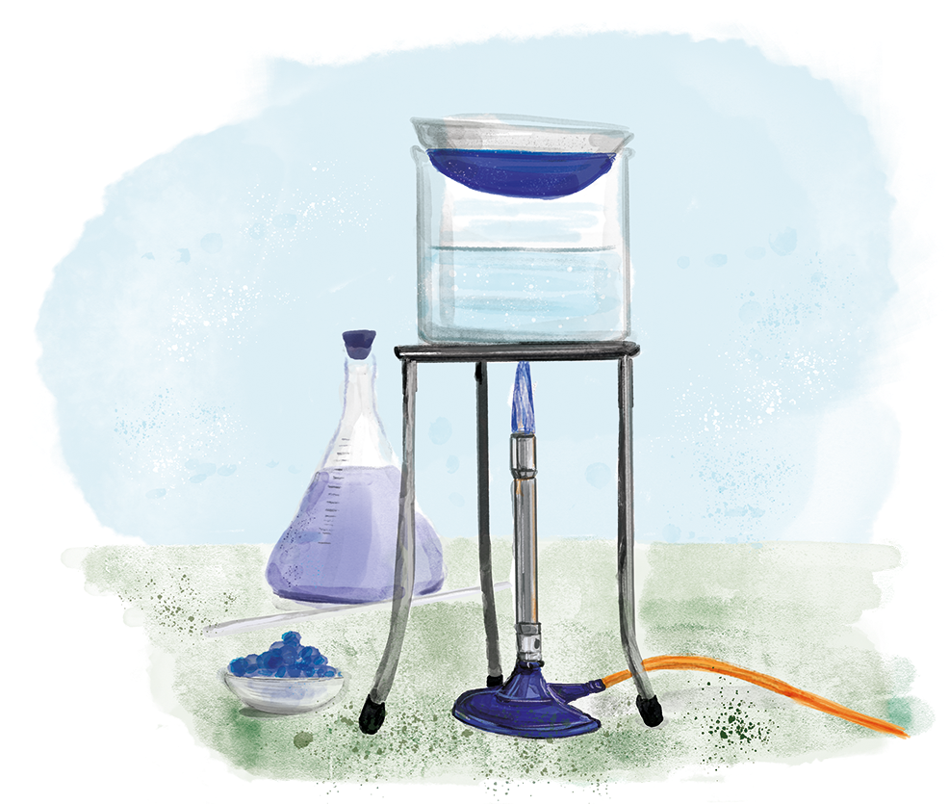
C4.3.6
03/02/2025
Taking it Further: Calculating Unknown Concentrations
C4.3.1 Prior Knowledge Review
C4.3.2 (HT) Introducing the Mole
C4.3.3 (HT) Mole Calculations
C4.3.4 PKR: Concentration
C4.3.5 TIF: Calculating Concentration
C4.3.6 TIF: Calculating Unknown Concentrations
C4.3.7 (HT) Amounts of Substances in Equations
C4.3.8 (HT) Limiting Reactants
C4.3.9 PKR: Reactions of Acids
C4.3.10 Acids, Alkalis and Neutralisation
C4.3.11 TIF: Acid-Alkali Titration
C4.3.12 TIF: Acid-Alkali Titration Analysis
C4.3.13 TIF: Titration Calculations
C4.3.14 (HT) Strong and Weak Acids
C4.3.15 TIF: Volumes of Gases
Notes:
Big idea: Reactions rearrange matter
In this lesson, which is chemistry only, students will build on their knowledge of concentration calculations, to be able to deduce unknown quantities from known quantities in a neutralisation reaction. This will prepare students to tackle titration calculations later in this unit.
Suggested Hook:
Sketch a particle diagram for a concentrated solution and a dilute solution. How will these be different?

Slide 6

Following this lesson, students will be able to:
Deduce the molar ratio of acid: alkali in a neutralisation reaction
Use molar ratio to calculate the number of moles of acid that react with a known number of moles of alkali
Calculate the concentration of one reactant in a neutralisation reaction, when the concentration and volume of the other reactant is known.
Key Words:
mass
volume
concentration
moles
molar ratio
Notes:
Guidance:
See unit overview document and planning guidance to see how these objectives are typically assessed at GCSE, including examples of what students should be able to do following this lesson.
Planning for different needs:
The learning objectives given on this slide are suggested based on the most common requirements for exams, however they can be adapted based on the needs of different classes.
For best practice, the unit preparation booklet should be used to determine the appropriate focus of lessons within the unit.
While it is not possible to explicitly split content into levelled grades, we recommend that lesson objectives can be classified as critical, core or stretch.
Critical: the content or skill is essential for all students to be able to progress.
Core: the content or skill is important for students to progress, but other opportunities may be available to revisit it.
Stretch: the content or skill may not be essential for all students but is important for students aiming for the highest grades.
Key skill: this is a crucial skill being developed in this unit as part of the skill mapping
C4.3.6 Lesson Objectives:
Core: Deduce the molar ratio of acid: alkali in a neutralisation reaction
Stretch: Use molar ratio to calculate the number of moles of acid that react with a known number of moles of alkali
Stretch: Calculate the concentration of one reactant in a neutralisation reaction, when the concentration and volume of the other reactant is known.

Slide 7
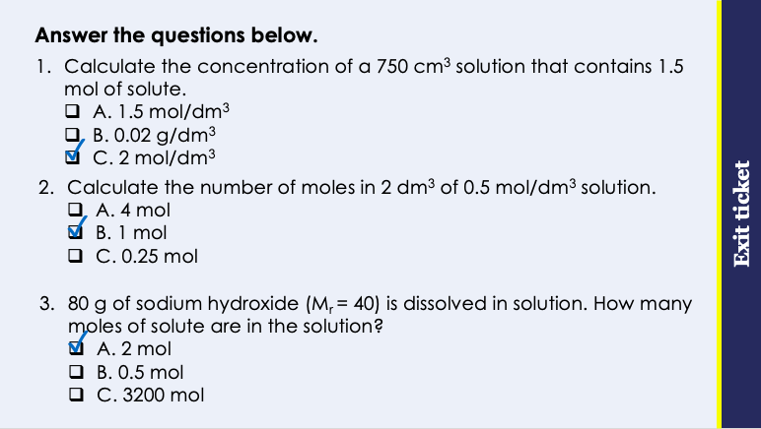
This is the fix-it portion of the lesson
The fix-it is an opportunity to respond to gaps in knowledge, especially those identified by the pre-unit quiz.
The teacher should customise this slide as needed, to facilitate
reteach, explanation, demonstration or modelling of ideas and concepts that students have not yet grasped or have misunderstood.
practise answering specific questions or of key skills.
redrafting or improving previous work.
Notes:
Purpose: to spend time on any gaps identified in previous learning from exit ticket.
Fix-it guidance from previous exit ticket:
Q1. Answer: C
If students answer A, it suggests they are not clear on the different units for concentration. If students answer B, they have used the correct calculation but have not converted to dm3. To fix it, give students more practice of identifying values given from written questions.
Q2. Answer: B
If students answer A, they have divided volume by concentration. If students answer C, they have divided concentration by volume. To fix it, remind the student of the correct formula to calculate concentration. Model the method to work this calculation out, and then give the student some similar calculations to try.
Q3. Answer: A
If students answer B, they have divided Mr by mass. If students answer C, they have multiplied mass by Mr. To fix it, give students more calculation practice, using mixed questions where students are solving between different unknowns for the different concentration equations and the mass/Mr equation.

Slide 8

What is a neutralisation reaction?
Did you know?
Roman soldiers were paid with salt (NaCl) and the word salary comes from the word ‘sal’ which means salt in Latin.
In neutralisation reactions an acid reacts with an alkali.
In this reaction a salt and water are the products.
acid + alkali → salt + water
.
Neutralisation forms a neutral solution. (pH 7)
E.g. potassium chloride is a metal compound; the metal is potassium and the acid it is made from is hydrochloric acid.
reactants
products
A salt is a metal compound made from acid.
K
Cl
Notes:
Exposition type: Explanation
Suggested exposition:
Neutralisation is a type of chemical reaction, which we can write word equations for. Neutralisation reaction occurs when an acid reacts with an alkali to produce salt and water. When acid and alkali are added in equal proportion of hydrogen and hydroxide this reaction produces a neutral solution with a pH 7. Neutralisation reaction can be represented in a general equation where the reactants are acid and alkali and the products are salt and water (Acid + Alkali -> salt + water). A general equation is one which shows the rules when certain types of substance react as they behave in similar ways.
Although neutralisation forms a neutral solution, not all salts produced from a neutralisation reaction are neutral (pH7).
Salt is a metal compound made from acid. A salt is formed when the hydrogen in an acid is replaced by a metal. For example, potassium chloride is a type of salt, potassium is a metal and the chloride comes from hydrochloric acid. (This idea will be discussed further in upcoming slides).
The salt that you will have eaten on chips and used when cooking has the chemical name sodium chloride but it is just one salt, it is not the only salt!
What reactants could have formed sodium chloride?
A compound of sodium and hydrochloric acid.
Note:
It is important to note here that not all salt have a pH of 7.
It’s a good idea to introduce students to the names of various other salts here. They should be able to see that part of these chemical names is a metal. Explain that all acids contain at least one Hydrogen atom (H), and all alkalis contain at least one OH (hydroxide), which join together to form the water. There’s no need at this stage to use the word ‘ion’, just the names of the elements involved.
I would be good to explain the meaning of compound again here to ensure that students understand why salts are considered a compound.
A good mnemonic for this reaction is AASW (Ants Always Swim in Water).
Common misconception: Neutralisation can be any physical mixing of an acid and an alkali, regardless of pH, and an assumption that all salt solutions have a pH of 7.

Slide 9

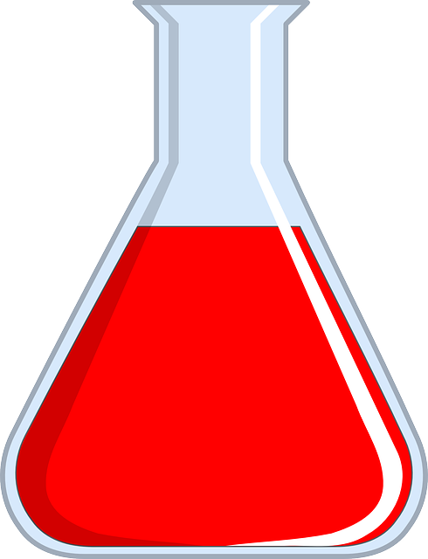
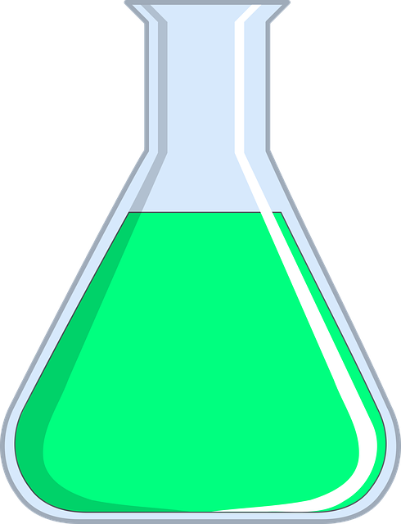
Linking an equation to the number of moles
Higher Tier only
Let’s take the example of a neutralisation reaction,
Potassium hydroxide + hydrochloric acid → Potassium chloride + water
1
1
1
1
KOH + HCl → KCl + H₂O
This equation tells us that 1 mole of potassium hydroxide reacts with 1 mole of hydrochloric acid, to make 1 mole of potassium chloride and 1 mole of water.
A student carried out the neutralisation reaction of potassium hydroxide and hydrochloric acid. The equation for the reaction is KOH + HCl → KCl + H₂O. The student reacted 5 moles of potassium hydroxide. How many moles of hydrochloric acid reacted?
5 moles
Notes:
Exposition type: Demonstration.
For this demonstration you will need:
A conical flask containing a dilute alkali solution
A beaker containing a dilute acid solution
Universal indicator solution
Model expert exposition:
We’re going to learn about using a reaction equation, and some known quantities, to calculate an unknown quantity.
To do this I’m going to take the example of this neutralisation reaction: potassium hydroxide (an alkali), reacts with hydrochloric acid (an acid) to make a salt (potassium chloride) and water.
Before we get into the calculation, demonstrate for students that this is a neutralisation reaction.
Add a few drops of universal indicator to each reactant. Note that the potassium hydroxide is an alkali. Write ‘alkali’ under this reactant on the board and the colour of the universal indicator in brackets next to this. Note that the hydrochloric acid is an acid. Write ‘acid’ under this reactant on the board and the colour of the universal indicator in brackets next to this.
Now, slowly add the acid to the alkali, swirling the flask as you go, until the mixture just turns neutral (green). Here you are basically doing a very simple titration to introduce this calculation for students. Note that the products are neutral. Write ‘neutral’ under the products on the board and the colour of the universal indicator in brackets next to this.
Looking at the equation for this reaction there is no coefficient written next to either the acid or alkali. This is the same as writing a ‘1’ next to each. You can write a 1 on the board next to these reactants to illustrate this point.
What this tells us is 1 mole of the alkali (potassium hydroxide) reacts with 1 mole of the acid. And that makes 1 mole of potassium chloride and 1 mole of water.
Why is this useful?
Because if you don’t know how many moles of acid reacted, but you do know how many moles of alkali reacted, then you can figure it out!
We can say that the molar ratio of acid to alkali is 1:1 (“1 to 1”).
So imagine I knew that 2 moles of alkali reacted and I didn’t know how many moles of acid reacted with it. If I know that 1 mole of acid always reacts with 1 mole of alkali (because the molar ratio is 1:1), then that means that 2 moles of alkali will react with 2 moles of acid.

Slide 10
Linking an equation to the number of moles
Higher Tier only
Let’s take the example of a neutralisation reaction,
Sodium hydroxide + sulfuric acid → sodium sulfate + water
2NaOH + H₂SO₄ → Na₂SO₄ + 2H₂O
This equation tells us that 2 moles of sodium hydroxide reacts with 1 mole of sulfuric acid, to make 1 mole of sodium sulfate and 2 moles of water.
A student carried out the neutralisation reaction of sodium hydroxide and sulfuric acid. The equation for the reaction is 2NaOH + H₂SO₄ → Na₂SO₄ + 2H₂O. The student reacted 6 moles of sodium hydroxide. How many moles of sulfuric acid reacted?
3 moles
Notes:
Exposition type: Demonstration.
For this demonstration you will need:
A conical flask containing a dilute alkali solution
A beaker containing a dilute acid solution
Universal indicator solution
Model expert exposition:
Let’s take another example of a neutralisation reaction: potassium hydroxide (an alkali), reacts with hydrochloric acid (an acid) to make a salt (potassium chloride) and water.
Before we get into the calculation, demonstrate for students that this is a neutralisation reaction.
Add a few drops of universal indicator to each reactant. Note that the sodium hydroxide is an alkali. Write ‘alkali’ under this reactant on the board and the colour of the universal indicator in brackets next to this. Note that the sulfuric acid is an acid. Write ‘acid’ under this reactant on the board and the colour of the universal indicator in brackets next to this.
Now, slowly add the acid to the alkali, swirling the flask as you go, until the mixture just turns neutral (green). Here you are basically doing a very simple titration to introduce this calculation for students. Note that the products are neutral. Write ‘neutral’ under the products on the board and the colour of the universal indicator in brackets next to this.
Looking at the equation for this reaction there is a ‘2’ coefficient written next to the alkali. There is no co-efficient next to the sulfuric acid, which is the same as having a ‘1’ there. Write a ‘1’ next to this reactant on the equation to illustrate this point. There is no co-efficient next to the product sodium sulfate, which is the same as having a ‘1’ there. Write a ‘1’ next to this product on the equation to illustrate this point. There is a ‘2’ coefficient written next to the product water. What this tells us is 2 moles of the alkali (sodium hydroxide) reacts with 1 mole of the acid. And that makes 1 mole of sodium sulfate and 2 moles of water.
We can say that the molar ratio of acid to alkali is 1:2 (“1 to 2”).
So imagine I knew that 10 moles of alkali reacted and I didn’t know how many moles of acid reacted with it. If I know that 1 mole of acid always reacts with 2 moles of alkali (because the molar ratio is 1:2), then that means that 10 moles of alkali will react with 5 moles of acid.

Slide 11
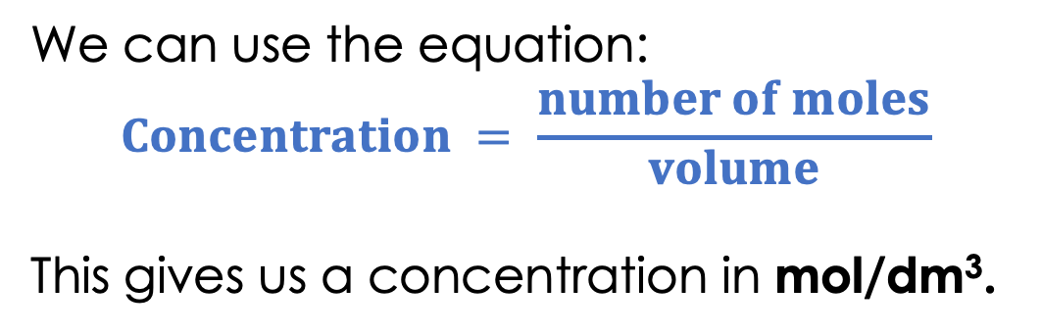
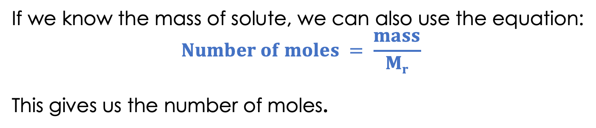
Mol/dm³
Higher Tier only
We can use the equation:
$$Concentration = \frac{number of moles}{volume}$$
This gives us a concentration in mol/dm³.
If we know the mass of solute, we can also use the equation:
$$Number of moles = \frac{mass}{Mr}$$
This gives us the number of moles.
Notes:
Suggested exposition:
When we calculate concentration, we have already calculated it as the mass of solute per unit volume. But we can also calculate it as the amount of solute per unit volume. Remember the amount of substance is the number of moles.
How many particles are there in one mole of any substance?
6.02 x 10²³
Sometimes we are given a mass of solute, or we ourselves add a certain mass of solute in grams to a solution. We can use another equation that we already know to work out how many moles there are in this mass of solute. Then we can use the calculation to determine concentration.
What is the equation that links number of moles, mass and Mr?
Number of moles = mass/Mr
Where do we get Mr from?
We can calculate it using the chemical formula and the relative atomic masses from the periodic table.

Slide 12

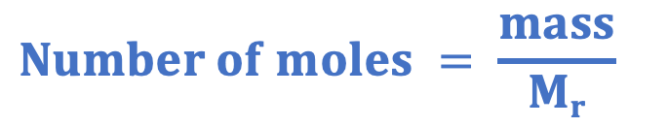



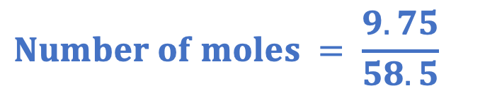
Worked Example
Higher Tier only
A scientist adds 9.75 g of sodium chloride to make 250 cm³ of salt solution.
What is the concentration of the solution in mol/dm³?
Mass = 9.75 g
$$Concentration= \frac{number of moles}{volume}$$
M_{r} (NaCl) = 23 + 35.5
= 58.5
$$Concentration= \frac{0.167}{0.25}$$
$$Number of moles = \frac{mass}{Mr}$$
$$Concentration=0.67 mol/dm 3$$
$$Number of moles = \frac{9.75}{58.5}$$
$$Number of moles =0.167 mol$$
Notes:
Suggested exposition:
Let’s look at a worked example. A scientist adds 50 g of sodium chloride to make 250 cm³ of salt solution. What is the concentration of the solution in mol/dm³?
If we were just calculating the concentration in g/dm³, we would simply use concentration = mass/volume.
But we’re not! We want to know exactly how much sodium chloride (in terms of particles, in this case ions) are in the solution.
What information do we have already?
Mass = 9.75 g.
What other information can we get from this question?
Volume - we’ll come back to that later.
And the formula: sodium chloride.
What is the formula for sodium chloride?
NaCl
What can we work out if we know the formula?
The Mr.
Now what can we work out?
Number of moles.
How?
Using number of moles = mass/Mr
This gives us 0.166666666666 on the calculator. For now, we can write this as 0.167 mol but we need to keep this number on our calculator for as long as we can to give us the most accurate final figure. So I’m writing 0.167, but keeping all those decimal places on the calculator.
Now how can we calculate concentration in mol/dm³?
Using concentration = number of moles/volume
Do we need to do anything to the 250 cm³?
Yes - convert to dm³ = 0.25 dm³.
Note: these numbers have been chosen to show students how to keep the values on the calculator. You may wish to use another example of more ‘whole’ numbers.

Slide 13



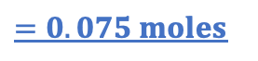

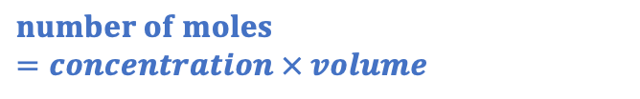
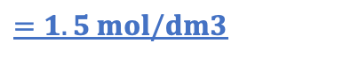
Calculating an Unknown Concentration
Higher Tier only
Potassium hydroxide + hydrochloric acid → Potassium chloride + water
KOH + HCl → KCl + H₂O
Volume = 0.15 dm³
Volume = 0.05 dm³
Concentration = 0.5 mol/dm³
Concentration = ?
$$Concentration= \frac{number of moles}{volume}$$
The mole ratio of alkali : acid is 1 : 1, or 0.075 : 0.075
$$Concentration= \frac{number of moles}{volume}$$
$$number of moles=concentration × volume$$
$$Concentration= \frac{0.075}{0.05}$$
$$number of moles=0.5 × 0.15$$
$$=1.5 mol/dm3$$
$$=0.075 moles$$
Notes:
Exposition type: Explanation.
Model expert exposition:
Let’s take what we know about linking an equation to the number of moles of reactants, and put this together with what we learned last lesson about calculating concentration.
In a neutralisation reaction, if we know
the balanced chemical equation for the reaction
the concentration and volume of one reactant
the volume of the other reactant
…we can calculate the concentration of the other reactant!
Let’s take this example of a neutralisation reaction. We can see that the molar ratio of alkali: acid (alkali to acid) is 1:1. So however many moles of alkali reacts, the same number of moles of acid will react.
We are given some information about both the alkali and the acid.
For the alkali, I can see that 0.15 dm³ is the volume of alkali that reacted.
This alkali has a concentration of 0.5 mol/dm³.
So, I know both the volume and concentration of the alkali. What does that allow me to calculate? The number of moles.
Number of moles can be calculated by multiplying concentration by volume. If we do this calculation we can see that 0.075 moles of alkali reacted.
Now let’s go back to the molar ratio.
As we said before, we can see that the molar ratio of alkali: acid (alkali to acid) is 1:1.
So if we have 0.075 moles of alkali, we must have the same number of moles of acid – that’s 0.075 moles.
Now looking at the acid, we know we have 0.075 moles of acid. And we know that we have a volume of 0.05 dm³. We need to find out the concentration of the acid. What formula can we use? Concentration = number of moles divided by volume.
So, let’s plug those numbers into the formula. We can see that the concentration of the acid is 1.5 mol/dm³.
So let’s recap what we did here.
We had an acid and alkali reacting in a neutralisation reaction.
We knew the volume and the concentration of one of these, which allowed us to calculate the number of moles of that reactant.
Knowing the number of moles of one reactant let’s us calculate the number of moles of the other reactant, because we know the molar ratio.
That then gives us enough information to calculate the concentration of the second reactant, because we now know the number of moles and the volume.

Slide 14
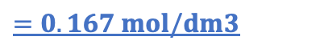

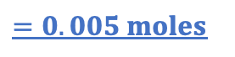

Calculating an Unknown Concentration
Higher Tier only
Sodium hydroxide + sulfuric acid → sodium sulfate + water
2NaOH + H₂SO₄ → Na₂SO₄ + 2H₂O
Volume = 25 cm³
Volume = 15 cm³
Concentration = 0.2 mol/dm³
Concentration = ?
$$Concentration= \frac{number of moles}{volume}$$
The mole ratio of alkali : acid is 2 : 1, or 0.005 : 0.0025
$$Concentration= \frac{number of moles}{volume}$$
$$number of moles=concentration × volume$$
$$Concentration= \frac{0.0025}{0.015}$$
$$number of moles=0.2 × 0.025$$
$$=0.167 mol/dm3$$
$$=0.005 moles$$
Notes:
Exposition type: Explanation.
Model expert exposition:
Let’s take what we know about linking an equation to the number of moles of reactants, and put this together with what we learned last lesson about calculating concentration.
In a neutralisation reaction, if we know
the balanced chemical equation for the reaction
the concentration and volume of one reactant
the volume of the other reactant
…we can calculate the concentration of the other reactant!
Let’s take this example of a neutralisation reaction. We can see that the molar ratio of alkali: acid (alkali to acid) is 2:1. So however many moles of alkali reacts, half of that number of moles of acid will react.
We are given some information about both the alkali and the acid.
For the alkali, I can see that 25 cm³ is the volume of alkali that reacted, which we need to convert into dm3.
This alkali has a concentration of 0.2 mol/dm³.
So, I know both the volume and concentration of the alkali. What does that allow me to calculate? The number of moles.
Number of moles can be calculated by multiplying concentration by volume. If we do this calculation we can see that 0.005 moles of alkali reacted.
Now let’s go back to the molar ratio.
As we said before, we can see that the molar ratio of alkali: acid (alkali to acid) is 2:1.
So if we have 0.005 moles of alkali, we must have half of that number of moles of acid – that’s 0.0025 moles.
Now looking at the acid, we know we have 0.0025 moles of acid. And we know that we have a volume of 15 cm³ (again which we need to convert to dm3). We need to find out the concentration of the acid. What formula can we use? Concentration = number of moles divided by volume.
So, let’s plug those numbers into the formula. We can see that the concentration of the acid is 0.167 mol/dm³.
So let’s recap what we did here.
We had an acid and alkali reacting in a neutralisation reaction.
We knew the volume and the concentration of one of these, which allowed us to calculate the number of moles of that reactant.
Knowing the number of moles of one reactant let’s us calculate the number of moles of the other reactant, because we know the molar ratio.
That then gives us enough information to calculate the concentration of the second reactant, because we now know the number of moles and the volume.

Slide 15




Discuss the answer to these questions with your partner.
A student carried out a neutralisation reaction.
The equation for the reaction is Ca(OH)₂ + 2HCl → CaCl₂ + 2H₂O.
The student reacted 25 cm³ of calcium hydroxide. The calcium hydroxide had a concentration of 0.05 mol/dm³. 10 cm³ of acid reacted.
1. Name the acid and the alkali in this reaction.
2. How many moles of the alkali reacted?
3. How many moles of the acid reacted?
4. What was the concentration of the acid?
Notes:
Answers:
Acid: hydrochloric acid. Alkali: Calcium hydroxide
0.00125 moles
0.0025 moles
0.025 mol/dm³
Suggested guidance:
Talk tasks can be used in a variety of ways to suit the particular needs of the students you are teaching. Through exchanging views with others, students develop their understanding of the science beyond what could be achieved individually.
Science classrooms that successfully integrate talk have the following features:
Science talk is a regular feature of lessons and is woven into classroom activities.
Students are paired or grouped strategically by the teacher to ensure productive interaction. This might take into consideration the students’ proficiency of the English language, how encouraging they might be to peers and their attainment in the topic. It’s a good idea to consider these pairings in the class seating plan.
Students are encouraged and supported to talk, but are not forced to talk.
The teacher should take on the role of a facilitator, engaging with conversations where necessary and encouraging or steering the conversation where needed.
Students are encouraged to use the language they have to express their ideas (e.g., everyday language, imperfect English, native language), but also to incorporate science specific terminology where this is more accurate or has been taught.
6. Scientifically inaccurate ideas are not dismissed by the partner or teacher; open discussion and further investigation are relied on to help students construct ideas that support them to progress in their scientific understanding.
7. Guidelines for behaviour during talk tasks are explicit and frequently reviewed. Rules for students might be:
Listen carefully to your partner
Take turns talking.
Speak one at a time, without interrupting.
Politely agree or disagree and explain why.
Politely point out if your partner has used a scientific word incorrectly, if they have explained the science incorrectly, or if there is a more accurate way to describe something.
If confused, ask questions.
Stay focused on the discussion topic.
Respond to one another.

Slide 16
Drill
State the equation that links concentration, mass and volume.
State the equation that links concentration, number of moles and volume.
State the equation that links number of moles, mass and relative formula mass.
Write a unit of volume.
Write a unit of concentration.
State the mole ratio of acid to alkali for the equation NaOH + HCl → NaCl + H₂O
Calculate the number of moles for a solution with a volume of 50 cm³ and a concentration of 0.5 mol/dm³.
Calculate the volume of a solution that contains 0.5 moles of solvent in a solution of concentration 1.5 mol/dm³
Notes:
Purpose: This is a knowledge drill. The purpose of this is to check that the critical knowledge is secure before pupils move onto independent practice.
Suggested guidance: There are a range of ways this could be done depending on time and ability range of the class:
Mini whiteboards
As full sentences in exercise books
As short answers in exercise books
In the pupil workbook
As pair talk
As cold call

Slide 17
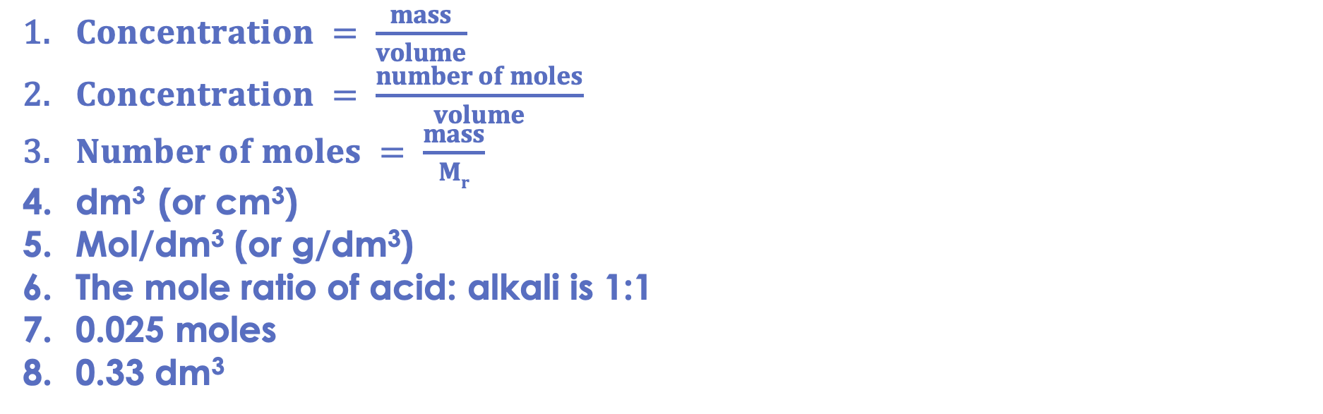
Drill answers
$Concentration = \frac{mass}{volume}$
$Concentration = \frac{number of moles}{volume}$
$Number of moles = \frac{mass}{Mr}$
dm³ (or cm³)
Mol/dm³ (or g/dm³)
The mole ratio of acid: alkali is 1:1
0.025 moles
0.33 dm³
Notes:
Purpose: This is a knowledge drill. The purpose of this is to check that the critical knowledge is secure before pupils move onto independent practice.
Suggested guidance: There are a range of ways this could be done depending on time and ability range of the class:
Mini whiteboards
As full sentences in exercise books
As short answers in exercise books
In the pupil workbook
As pair talk
As cold call

Slide 18
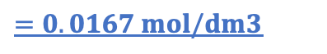

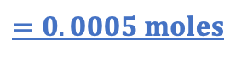

Calculating an Unknown Concentration
Higher Tier only
Sodium hydroxide + sulfuric acid → sodium sulfate + water
2NaOH + H₂SO₄ → Na₂SO₄ + 2H₂O
Volume = 25 cm³
Volume = 15 cm³
Concentration = 0.02 mol/dm³
Concentration = ?
$$Concentration= \frac{number of moles}{volume}$$
The mole ratio of alkali : acid is 2 : 1, or 0.0005 : 0.00025
$$Concentration= \frac{number of moles}{volume}$$
$$number of moles=concentration × volume$$
$$Concentration= \frac{0.00025}{0.015}$$
$$number of moles=0.02 × 0.025$$
$$=0.0167 mol/dm3$$
$$=0.0005 moles$$
Notes:
Exposition type: Explanation.
Model expert exposition:
Let’s take what we know about linking an equation to the number of moles of reactants, and put this together with what we learned last lesson about calculating concentration.
In a neutralisation reaction, if we know
the balanced chemical equation for the reaction
the concentration and volume of one reactant
the volume of the other reactant
…we can calculate the concentration of the other reactant!
Let’s take this example of a neutralisation reaction. We can see that the molar ratio of alkali: acid (alkali to acid) is 2:1. So however many moles of alkali reacts, half of that number of moles of acid will react.
We are given some information about both the alkali and the acid.
For the alkali, I can see that 25 cm³ is the volume of alkali that reacted.
This alkali has a concentration of 0.02 mol/dm³.
So, I know both the volume and concentration of the alkali. What does that allow me to calculate? The number of moles.
Number of moles can be calculated by multiplying concentration by volume. If we do this calculation we can see that 0.0005 moles of alkali reacted.
Now let’s go back to the molar ratio.
As we said before, we can see that the molar ratio of alkali: acid (alkali to acid) is 2:1.
So if we have 0.0005 moles of alkali, we must have half of that number of moles of acid – that’s 0.00025 moles.
Now looking at the acid, we know we have 0.00025 moles of acid. And we know that we have a volume of 15 cm³. We need to find out the concentration of the acid. What formula can we use? Concentration = number of moles divided by volume.
So, let’s plug those numbers into the formula. We can see that the concentration of the acid is 0.0167 mol/dm³.
So let’s recap what we did here.
We had an acid and alkali reacting in a neutralisation reaction.
We knew the volume and the concentration of one of these, which allowed us to calculate the number of moles of that reactant.
Knowing the number of moles of one reactant let’s us calculate the number of moles of the other reactant, because we know the molar ratio.
That then gives us enough information to calculate the concentration of the second reactant, because we now know the number of moles and the volume.

Slide 19
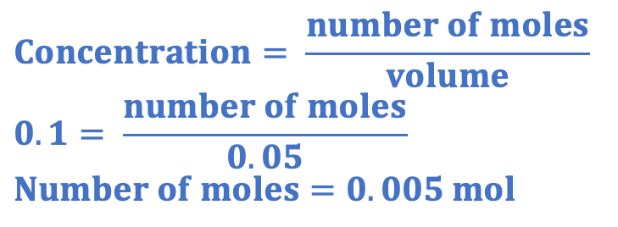

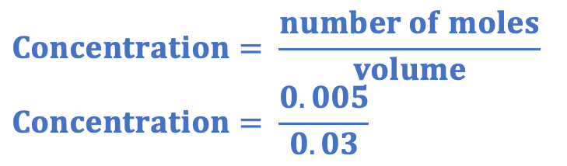
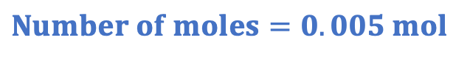
I: Calculating an unknown concentration
50 cm³ of 0.1 mol/dm³ lithium hydroxide reacts with 30 cm³ of hydrochloric acid.
The equation for the reaction is:
LiOH + HCl → LiCl + H₂O
How many moles of lithium hydroxide reacted?
$$Concentration= \frac{number of moles}{volume}$$
$$0.1= \frac{number of moles}{0.05}$$
$$Number of moles=0.005 mol$$
What is the mole ratio of alkali to acid in this reaction?
1:1
How many moles of hydrochloric acid reacted?
$$Number of moles=0.005 mol$$
What is the concentration of the hydrochloric acid?
$$Concentration= \frac{number of moles}{volume}$$
$$Concentration= \frac{0.005}{0.03}$$
$$Concentration=0.167 mol/dm 3$$
Notes:
Purpose: The I-We-You section aims to support pupils to build skills that they most commonly need when answering questions associated with this knowledge in the assessment. This section is also used to interleave other content we expect pupils to know at this stage of their education in order that they build a big picture of the science they are learning.
For the ‘I’ activity, the teacher should model how to answer the question. They can do this by narrating their thinking process aloud, and making links to learning earlier in the lesson explicit.
For the ‘we’ activity, the teacher and students work though a similar example together, in order to prepare students to be able to answer a similar question independently.
Opportunities for the ‘you’ activity – independent practise – occur in the activity portion of the lesson once the student is secure enough to process independently.

Slide 20

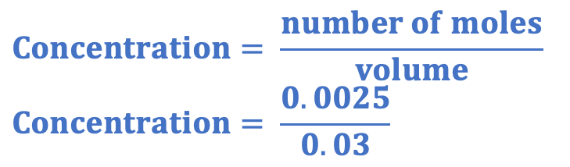
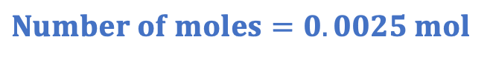
We: Calculating an unknown concentration
50 cm³ of 0.1 mol/dm³ lithium hydroxide reacts with 30 cm³ of sulfuric acid.
The equation for the reaction is:
2 LiOH + H₂SO₄ → Li₂SO₄ + 2 H₂O
How many moles of lithium hydroxide reacted?
$$Concentration= \frac{number of moles}{volume}$$
$$0.1= \frac{number of moles}{0.05}$$
$$Number of moles=0.005 mol$$
What is the mole ratio of alkali to acid in this reaction?
2:1
How many moles of sulfuric acid reacted?
$$Number of moles=0.0025 mol$$
What is the concentration of the sulfuric acid?
$$Concentration= \frac{number of moles}{volume}$$
$$Concentration= \frac{0.0025}{0.03}$$
$$Concentration=0.083 mol/dm 3$$
Notes:
Purpose: The I-We-You section aims to support pupils to build skills that they most commonly need when answering questions associated with this knowledge in the assessment. This section is also used to interleave other content we expect pupils to know at this stage of their education in order that they build a big picture of the science they are learning.
For the ‘I’ activity, the teacher should model how to answer the question. They can do this by narrating their thinking process aloud, and making links to learning earlier in the lesson explicit.
For the ‘we’ activity, the teacher and students work though a similar example together, in order to prepare students to be able to answer a similar question independently.
Opportunities for the ‘you’ activity – independent practise – occur in the activity portion of the lesson once the student is secure enough to process independently.

Slide 21
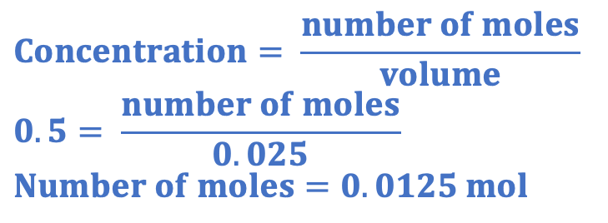

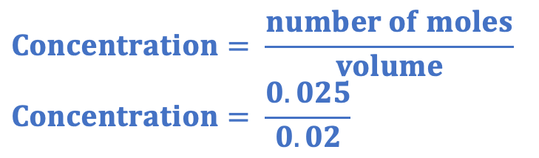

You: Calculating an unknown concentration
25 cm³ of 0.5 mol/dm³ barium hydroxide reacts with 20 cm³ of hydrochloric acid.
The equation for the reaction is:
Ba(OH)₂ + 2 HCl → BaCl₂ + 2 H₂O
How many moles of barium hydroxide reacted?
$$Concentration= \frac{number of moles}{volume}$$
$$0.5= \frac{number of moles}{0.025}$$
$$Number of moles=0.0125 mol$$
What is the mole ratio of alkali to acid in this reaction?
1:2
How many moles of hydrochloric acid reacted?
$$Number of moles=0.025 mol$$
What is the concentration of the hydrochloric acid?
$$Concentration= \frac{number of moles}{volume}$$
$$Concentration= \frac{0.025}{0.02}$$
$$Concentration=1.25 mol/dm 3$$
Notes:
Purpose: The I-We-You section aims to support pupils to build skills that they most commonly need when answering questions associated with this knowledge in the assessment. This section is also used to interleave other content we expect pupils to know at this stage of their education in order that they build a big picture of the science they are learning.
For the ‘I’ activity, the teacher should model how to answer the question. They can do this by narrating their thinking process aloud, and making links to learning earlier in the lesson explicit.
For the ‘we’ activity, the teacher and students work though a similar example together, in order to prepare students to be able to answer a similar question independently.
Opportunities for the ‘you’ activity – independent practise – occur in the activity portion of the lesson once the student is secure enough to process independently.

Slide 22
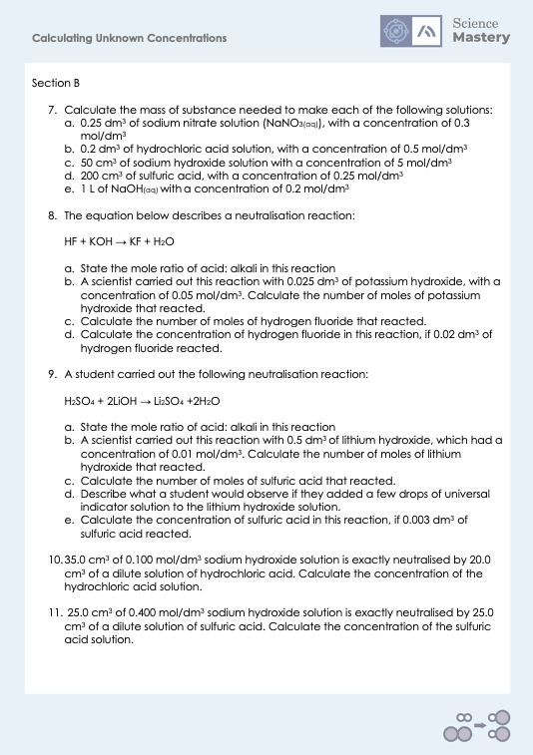
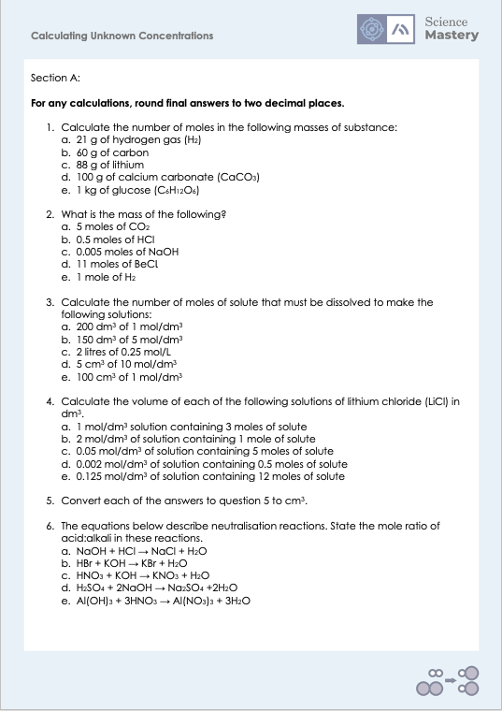
Activity
Notes:
The activity for this lesson is a review of concentration and number of moles calculations, with lots and lots of practice questions.

Slide 23
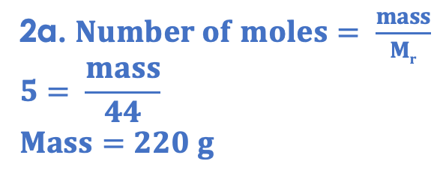
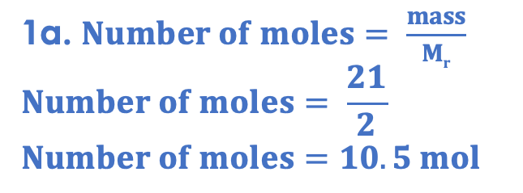
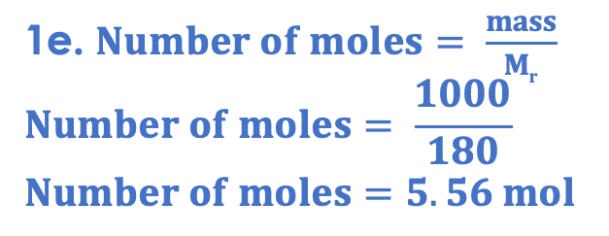
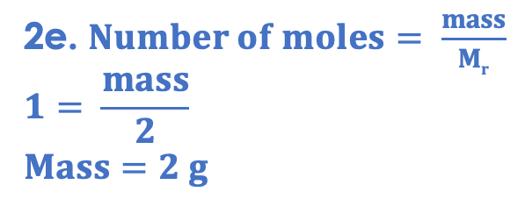
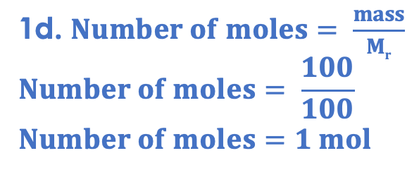
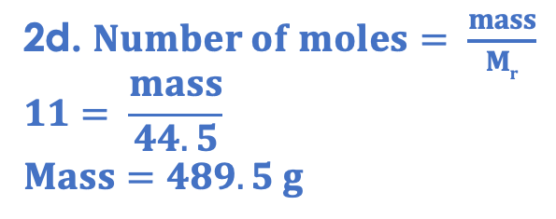
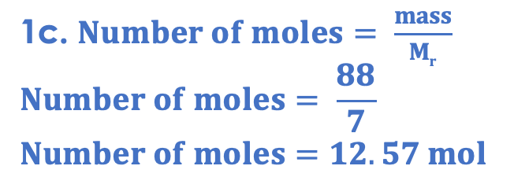
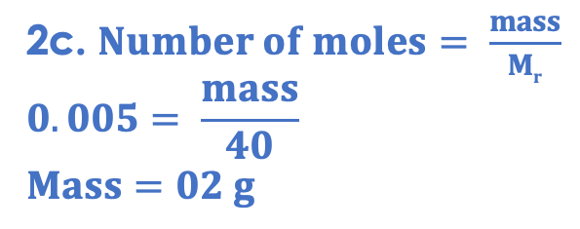
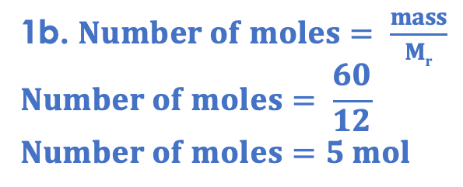
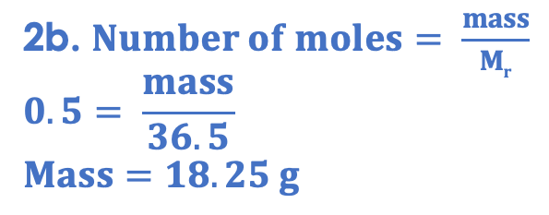
Answers
1a. $Number of moles= \frac{mass}{Mr}$
$$Number of moles= \frac{21}{2}$$
$$Number of moles=10.5 mol$$
1e. $Number of moles= \frac{mass}{Mr}$
$$Number of moles= \frac{1000}{180}$$
$$Number of moles=5.56 mol$$
2d. $Number of moles= \frac{mass}{Mr}$
$$11= \frac{mass}{44.5}$$
$$Mass=489.5 g$$
1b. $Number of moles= \frac{mass}{Mr}$
$$Number of moles= \frac{60}{12}$$
$$Number of moles=5 mol$$
2a. $Number of moles= \frac{mass}{Mr}$
$$5= \frac{mass}{44}$$
$$Mass=220 g$$
2e. $Number of moles= \frac{mass}{Mr}$
$$1= \frac{mass}{2}$$
$$Mass=2 g$$
1c. $Number of moles= \frac{mass}{Mr}$
$$Number of moles= \frac{88}{7}$$
$$Number of moles=12.57 mol$$
2b. $Number of moles= \frac{mass}{Mr}$
$$0.5= \frac{mass}{36.5}$$
$$Mass=18.25 g$$
1d. $Number of moles= \frac{mass}{Mr}$
$$Number of moles= \frac{100}{100}$$
$$Number of moles=1 mol$$
2c. $Number of moles= \frac{mass}{Mr}$
$$0.005= \frac{mass}{40}$$
$$Mass=02 g$$

Slide 24
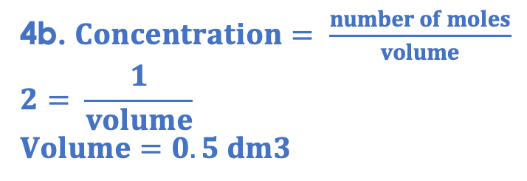
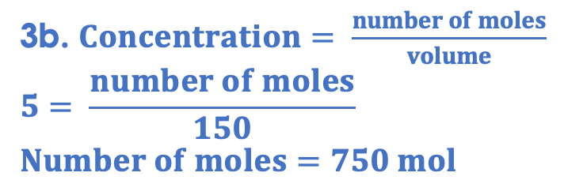
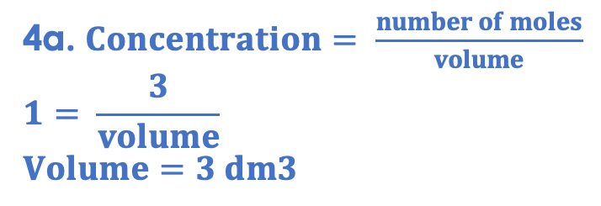

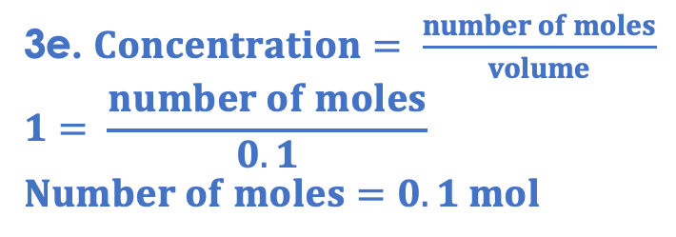
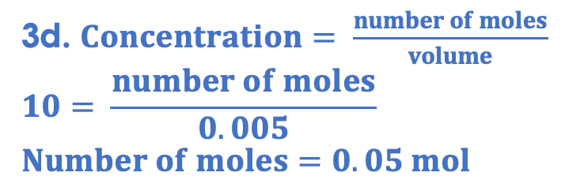
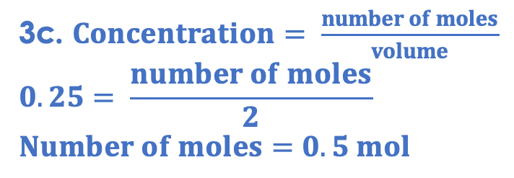
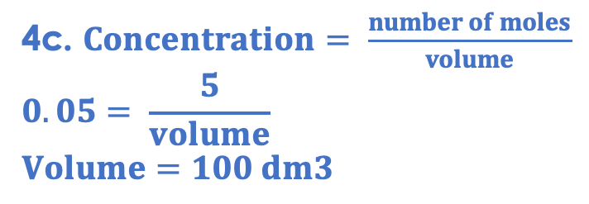
Answers
3a. $Concentration= \frac{number of moles}{volume}$
$$1= \frac{number of moles}{200}$$
$$Number of moles=200 mol$$
3e. $Concentration= \frac{number of moles}{volume}$
$$1= \frac{number of moles}{0.1}$$
$$Number of moles=0.1 mol$$
3b. $Concentration= \frac{number of moles}{volume}$
$$5= \frac{number of moles}{150}$$
$$Number of moles=750 mol$$
4a. $Concentration= \frac{number of moles}{volume}$
$$1= \frac{3}{volume}$$
$$Volume=3 dm3$$
3c. $Concentration= \frac{number of moles}{volume}$
$$0.25= \frac{number of moles}{2}$$
$$Number of moles=0.5 mol$$
4b. $Concentration= \frac{number of moles}{volume}$
$$2= \frac{1}{volume}$$
$$Volume=0.5 dm3$$
3d. $Concentration= \frac{number of moles}{volume}$
$$10= \frac{number of moles}{0.005}$$
$$Number of moles=0.05 mol$$
4c. $Concentration= \frac{number of moles}{volume}$
$$0.05= \frac{5}{volume}$$
$$Volume=100 dm3$$

Slide 25
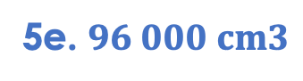
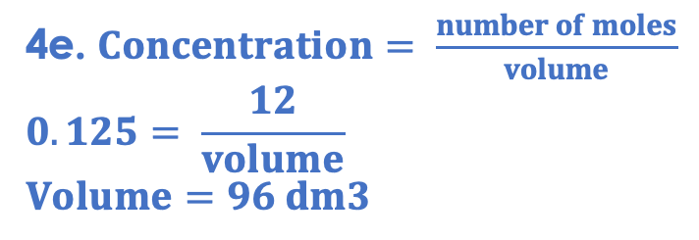

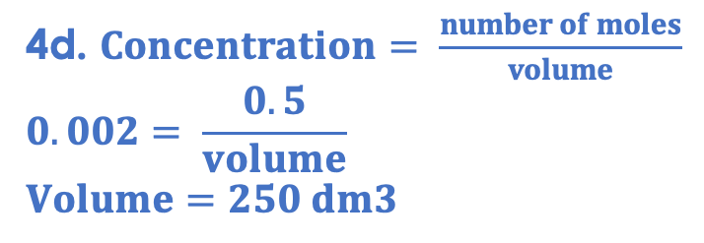



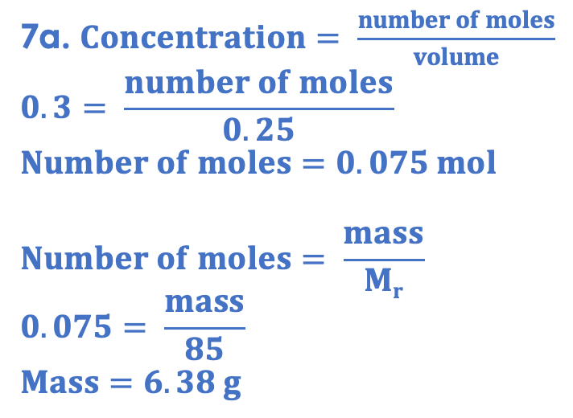
Answers
4d. $Concentration= \frac{number of moles}{volume}$
$$0.002= \frac{0.5}{volume}$$
$$Volume=250 dm3$$
6a. 1:1
6b. 1:1
6c. 1:1
4e. $Concentration= \frac{number of moles}{volume}$
$$0.125= \frac{12}{volume}$$
$$Volume=96 dm3$$
6d. 1:2
6e. 3:1
7a. $Concentration= \frac{number of moles}{volume}$
$$0.3= \frac{number of moles}{0.25}$$
$$Number of moles=0.075 mol$$
$$Number of moles= \frac{mass}{Mr}$$
$$0.075= \frac{mass}{85}$$
$$Mass=6.38 g$$
5a. $3000 cm3$
5b. $500 cm3$
5c. $100 000 cm3$
5d. $250 000 cm3$
5e. $96 000 cm3$

Slide 26
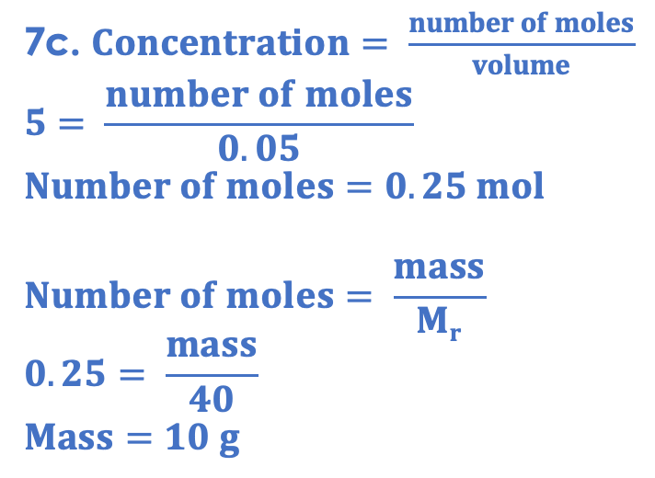
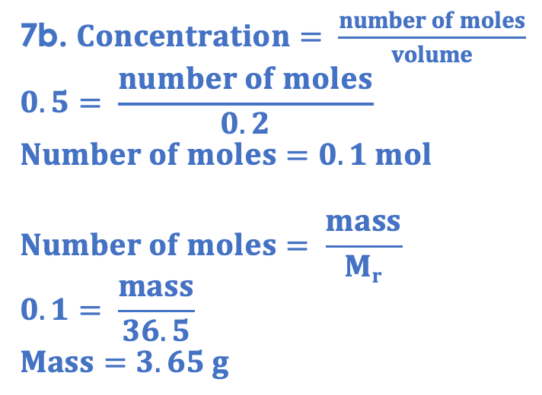
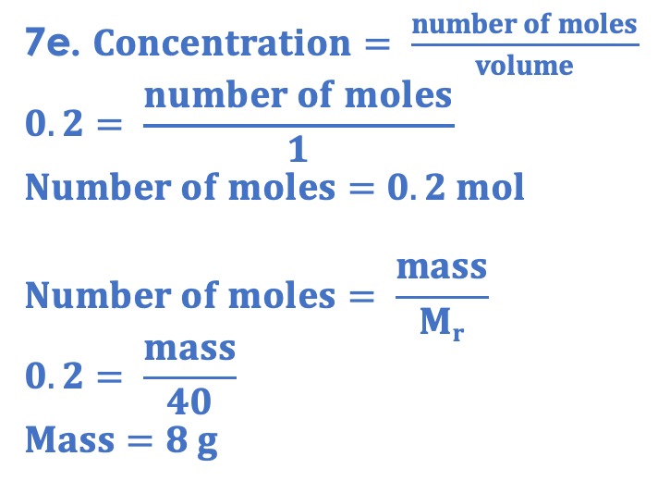
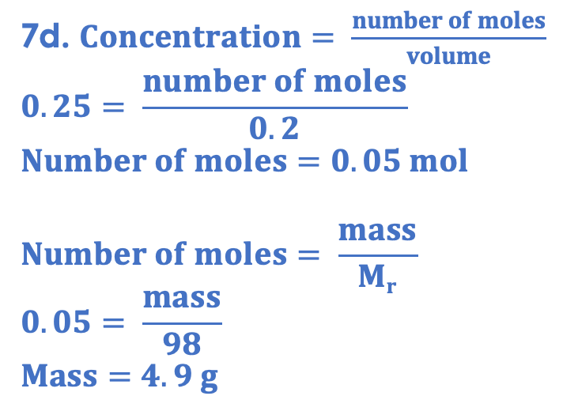
Answers
7b. $Concentration= \frac{number of moles}{volume}$
$$0.5= \frac{number of moles}{0.2}$$
$$Number of moles=0.1 mol$$
$$Number of moles= \frac{mass}{Mr}$$
$$0.1= \frac{mass}{36.5}$$
$$Mass=3.65 g$$
7d. $Concentration= \frac{number of moles}{volume}$
$$0.25= \frac{number of moles}{0.2}$$
$$Number of moles=0.05 mol$$
$$Number of moles= \frac{mass}{Mr}$$
$$0.05= \frac{mass}{98}$$
$$Mass=4.9 g$$
7c. $Concentration= \frac{number of moles}{volume}$
$$5= \frac{number of moles}{0.05}$$
$$Number of moles=0.25 mol$$
$$Number of moles= \frac{mass}{Mr}$$
$$0.25= \frac{mass}{40}$$
$$Mass=10 g$$
7e. $Concentration= \frac{number of moles}{volume}$
$$0.2= \frac{number of moles}{1}$$
$$Number of moles=0.2 mol$$
$$Number of moles= \frac{mass}{Mr}$$
$$0.2= \frac{mass}{40}$$
$$Mass=8 g$$

Slide 27






Answers
9a. 1:2
9b. $Concentration= \frac{number of moles}{volume}$
$$0.01= \frac{number of moles}{0.5}$$
$$Number of moles=5{ ×10}^{−3} mol$$
8a. 1:1
8b. $Concentration= \frac{number of moles}{volume}$
$$0.05= \frac{number of moles}{0.025}$$
$$Number of moles=1.25{ ×10}^{−3} mol$$
9c.
Ratio= 1:2
$$Number of moles H2SO4=2.5{ ×10}^{−3} mol$$
8c.
Ratio= 1:1
$$Number of moles HF=1.25{ ×10}^{−3} mol$$
9d. Universal indicator would turn purple/blue when added to lithium hydroxide solution. However, when this has been neutralised by the sulfuric acid, the Universal indicator would turn green.
8d. $Concentration= \frac{number of moles}{volume}$
$$Concentration= \frac{1.25{ ×10}^{−3}}{0.02}$$
$$Concentration=0.0625 mol/dm 3$$
9e. $Concentration= \frac{number of moles}{volume}$
$$Concentration= \frac{2.5{ ×10}^{−3}}{0.003}$$
$$Concentration=0.833 mol/dm 3$$

Slide 28


Answers
10. NaOH + HCl → NaCl + H₂O
NaOH:
$$Concentration= \frac{number of moles}{volume}$$
$$0.1= \frac{number of moles}{0.035}$$
$$Number of moles=3.5{ ×10}^{−3} mol$$
Ratio= 1:1
$$Number of moles HCl=3.5{ ×10}^{−3}mol$$
$$Concentration= \frac{number of moles}{volume}$$
$$Concentration= \frac{3.5{ ×10}^{−3}}{0.02}$$
$$Concentration=0.175 mol/dm 3$$
11. 2 NaOH + H₂SO₄ → Na₂SO₄ + 2 H₂O
NaOH:
$$Concentration= \frac{number of moles}{volume}$$
$$0.4= \frac{number of moles}{0.025}$$
$$Number of moles=0.01 mol$$
Ratio= 2:1
$$Number of moles H2SO4=5{ ×10}^{−3}mol$$
$$Concentration= \frac{number of moles}{volume}$$
$$Concentration= \frac{5{ ×10}^{−3}}{0.025}$$
$$Concentration=0.2 mol/dm 3$$

Slide 29

Answer the questions below.
What is the equation that links concentration, number of moles and volume?
A. $Concentration = \frac{number of moles}{volume}$
B. $Number of moles = \frac{concentration}{volume}$
C. $Concentration =number of moles × volume$
✓
Calculate the number of moles in 100 cm³ of 0.2 mol/dm³ solution.
A. 20 mol
B. 2 mol
C. 0.02 mol
✓
Sodium hydroxide reacts with hydrochloric acid:
NaOH + HCl → NaCl + H₂O
What is the mole ratio of alkali to acid in this reaction?
A. 1:1
B. 4:2
C. Need more information
✓
Notes:
Q1. Answer: A
If students answer B or C, it suggests they are not clear on equation that links concentration, number of moles and volume. To fix it, review the equation and the units for each quantity, showing how the units for concentration can be derived from the equation.
Q2. Answer: C
If students answer A, they have not converted from cm3 to dm3. If students answer B, they have divided concentration by volume. To fix it, remind the student of the correct formula to calculate concentration. Model the method to work this calculation out, and then give the student some similar calculations to try.
Q3. Answer: A
If students answer B, they have confused the number of atoms in the formula for each with the meaning of (or lack of) coefficients. If students answer C, they have not realised the relationship between the coefficients and the mole ratio. This will be addressed again in the next lesson. To fix it, give students more practice of calculations where they have to first identify the mole ratio.

Slide 30
Lesson C4.3.6
What was good about this lesson? | What can we do to improve this lesson?
Send us your feedback by clicking this link
or by emailing sciencemastery@arkonline.org
Thank you!

